Slide 1

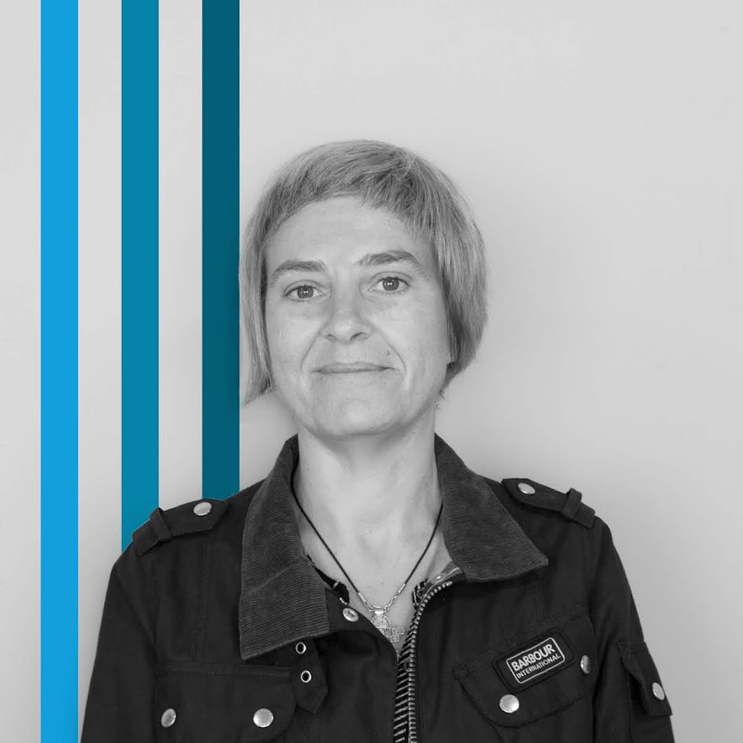
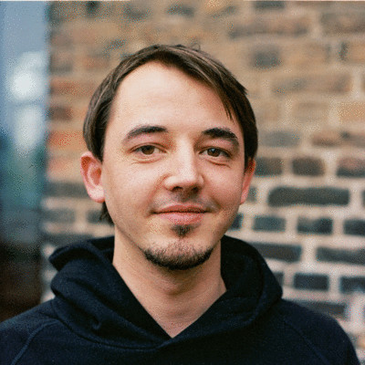
The fabulous G4
Fabian Hieber
Mónia Gomes
Moritz Neujeffski

Slide 2
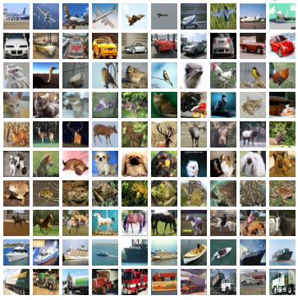
Dataset - Object Recognition in Images
CIFAR – 10
Notes:
Dataset Chosen The CIFAR-10 dataset, consists of 60000 32x32 color images in 10 classes, with 6000 images per class. There are 50000 training images and 10000 test images.

Slide 3
Problem Overview
Notes:
Problem Overview:
Describe the problem you're solving (1 slide).

Slide 4
Data Preprocessing (1/2)
Notes:
Data Preprocessing:
Detail your data preprocessing steps. Use diagrams to visualize the process (1-2 slides).

Slide 5
Data Preprocessing (2/2)
Notes:
Data Preprocessing:
Detail your data preprocessing steps. Use diagrams to visualize the process (1-2 slides).

Slide 6
CNN Architecture (1/2)
Notes:
CNN Architecture:
Present the CNN architecture you designed, using diagrams to illustrate (1-2 slides).

Slide 7
CNN Architecture (2/2)
Notes:
CNN Architecture:
Present the CNN architecture you designed, using diagrams to illustrate (1-2 slides).

Slide 8
Optimization Techniques
Notes:
Optimization Techniques:
Mention the optimization techniques applied (1 slide).

Slide 9
Transfer Learning (1/2)
Notes:
Transfer Learning:
Specify the pretrained model, explain why it was chosen, and any modifications made (1-2 slides).

Slide 10
Transfer Learning (2/2)
Notes:
Transfer Learning:
Specify the pretrained model, explain why it was chosen, and any modifications made (1-2 slides).

Slide 11
Evaluation (1/2)
Notes:
valuation:
Show evaluation metrics, confusion matrix, and related plots (2-4 slides).

Slide 12
Evaluation (2/2)
Notes:
valuation:
Show evaluation metrics, confusion matrix, and related plots (2-4 slides).

Slide 13
Model Deployment (Optional)
Notes:
Model Deployment (optional):
If applicable, mention how you deployed the model (bonus).

Slide 14
Project Overview / Recap
Notes:
Project Overview/Recap:
Provide a final summary of the project (1 slide).

